Slide 1
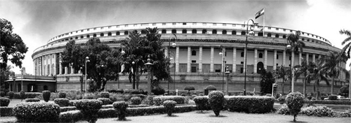
What deters the unveiling of legislative process?
A Study from Indian Perspective
Open Legislative Data in Paris II :Time Has Come for Law Tracking, Paris, 28th of May, 2014
Dr. Manisha Madhava,

Slide 2
Problem
Transparency in the Law making Process in developing but highly democratic countries like India is limited by :
  Difficulties of locating the process of law making
  Locating the actors
  Defining Law making
  Primary function of the Legislature : Lawmaking Vs. Representation
  Apathy of Actors ( MP’s and citizens) to law making functions
  Institutional Bottlenecks

Slide 3

Framework
Constitutional Framework
The Political Context
    Locating the Process
    Locating the Law Makers
The Institutional Context
    Bottlenecks
Existing Efforts
Road Ahead
What deters the unveiling of Legislative Process?

Slide 4
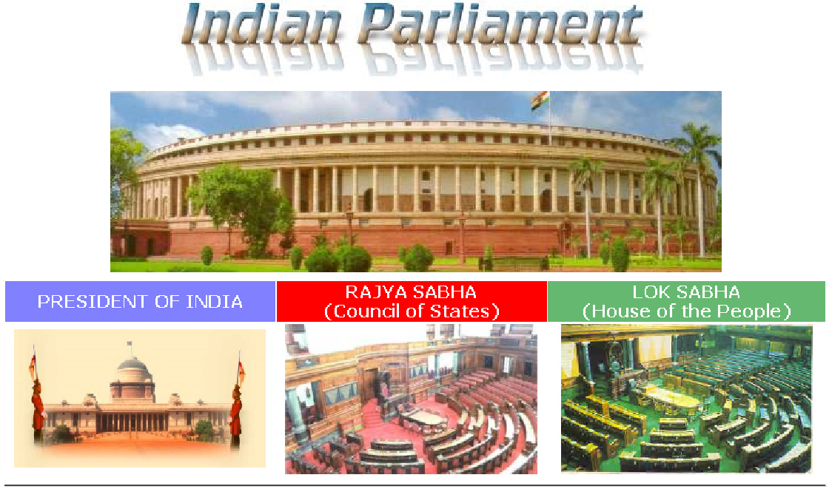
Constitutional Structure
Parliamentary Democracy of the British type with a bi cameral legislature
Federal Form of Government
Powerful Parliament
to make laws on all matters included in the Union list as well as the concurrent list
power to amend the constitution of India,
infringe or expand fundamental rights,
carve out new units by altering the boundaries of existing units and
change the name, territory and boundaries of the units
What deters the unveiling of Legislative Process?

Slide 5
The Political Context
Determining the Policy Agenda
1
Democratization & Its Repercussions
2
Rise of Regional Parties
3
Changing Socio- Economic Profile
4
Demands of Coalition Politics
5
Courtesy: Times of India
What deters the unveiling of Legislative Process?

Slide 6
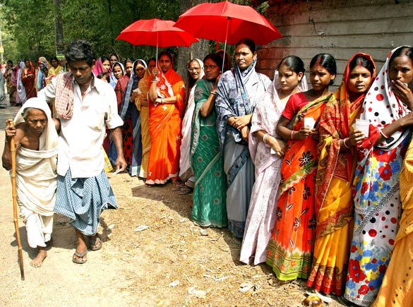
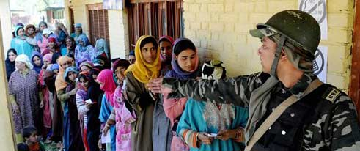
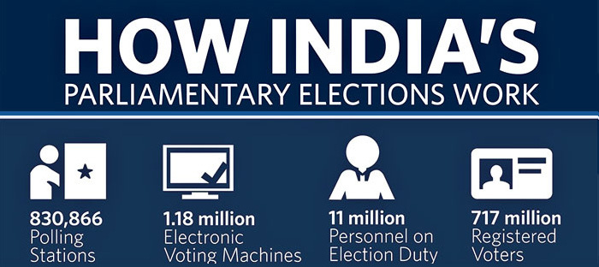
Democratization
856

Slide 7
Democratization
Voter Turn out has increased from 45% to 66 % in 2004
The increase in turn out has been due to the participation of Marginalized
Source: Election Commission of India

Slide 8
Vote Share
Source: Election Commission of India
What deters the unveiling of Legislative Process?

Slide 9
Seat Share
What deters the unveiling of Legislative Process?
Source: Election Commission of India

Slide 10
Democratizing Social Profile
What deters the unveiling of Legislative Process?
Source: Lok Sabha Secretariat

Slide 11
Caste Composition of the 15th Lok Sabha
Scheduled Castes & Tribes
Muslims
SC & ST: The constitution of India reserves 22% seats for SC & Tribes, who are socio economically under privileged sections of the Society
Other Backward Castes are the socially backward castes.. In the 1990’s there has been significant consolidation of OBC’s and their representation has improved significantly
Muslims and Women Continue to be under represented in the Parliament

Slide 12
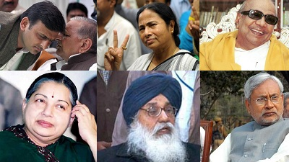
Locating the Process
Role of States and State level Leader
1
Influencing Law making from Outside
2
Formalism of Legislative Process
3
1
Redefining Legislative Functions
4
What deters the unveiling of Legislative Process?

Slide 13
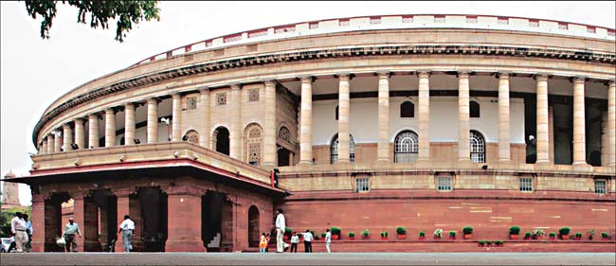
Locating the Law Makers
Coalition Parties
Ministers
State level leaders
    Political Parties
    Business groups,
    religious and caste leaders
What deters the unveiling of Legislative Process?

Slide 14
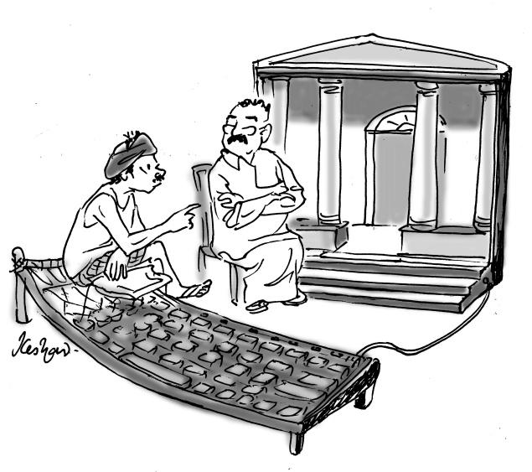
The Institutional Context:
Bottlenecks
Disinterested MP’s
  Inadequate recognition of
  parliamentary work
  Low impact on the career prospects
  Generalist Composition
Insufficient time
Lack of Transparency
Inadequate Consultation
Disengagement
Unclear Party Platforms

Slide 15
Time Spent by Lok Sabha in Different Activities
Source: Lok Sabha Secretariat

Slide 16
Report of the National Advisory Committee
Law-making in India is a process that is becoming increasingly contentious and controversial. A typical Bill is drafted in secret by the concerned government department (sometimes in consultation with other departments, and often with just a few bureaucrats hastily preparing a draft), and this secret draft is approved by the Cabinet for presentation before a House of Parliament (or the State Legislature, as the case may be). Usually, it is only upon its introduction in the House that the contents of the Bill are made public. The attention paid to a typical Bill in Parliament can be deduced”
    In 2009, only 16% of the total Parliamentary time was spent on legislative business.
    27% of the total Bills passed in the year by Lok Sabha were discussed for less than 5 minutes.
    Only five Bills passed by the Lok Sabha in 2009 were debated for more than three hours.

Slide 17
Lack of Transparency & Inadequate Consultation
The only opportunity for people to express their opinion before passage of the law is if it is sent to a parliamentary committee
Functioning of these committees is opaque
Making the contents of draft Bills public rests on the magnanimity of the Ministry concerned
Even the main opposition parties are rarely consulted during the drafting process
What deters the unveiling of Legislative Process?

Slide 18
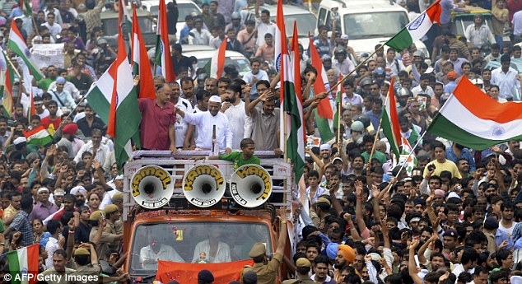
Demanding the Right to Participation in the Law making Process: Demonstrations for the Lokpal (Ombudsman) Bill

Slide 19
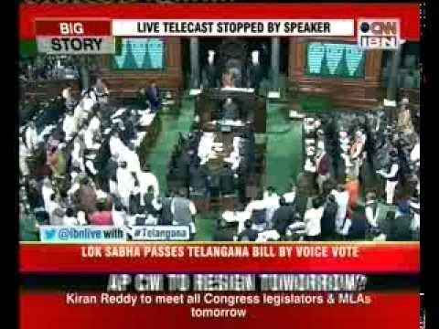
Tracking the Law Making Process: Attempts So Far
Digitization
Television Coverage
Media Initiatives
Right to Information Bill
Pre Legislative Process bill
What deters the unveiling of Legislative Process?

Slide 20
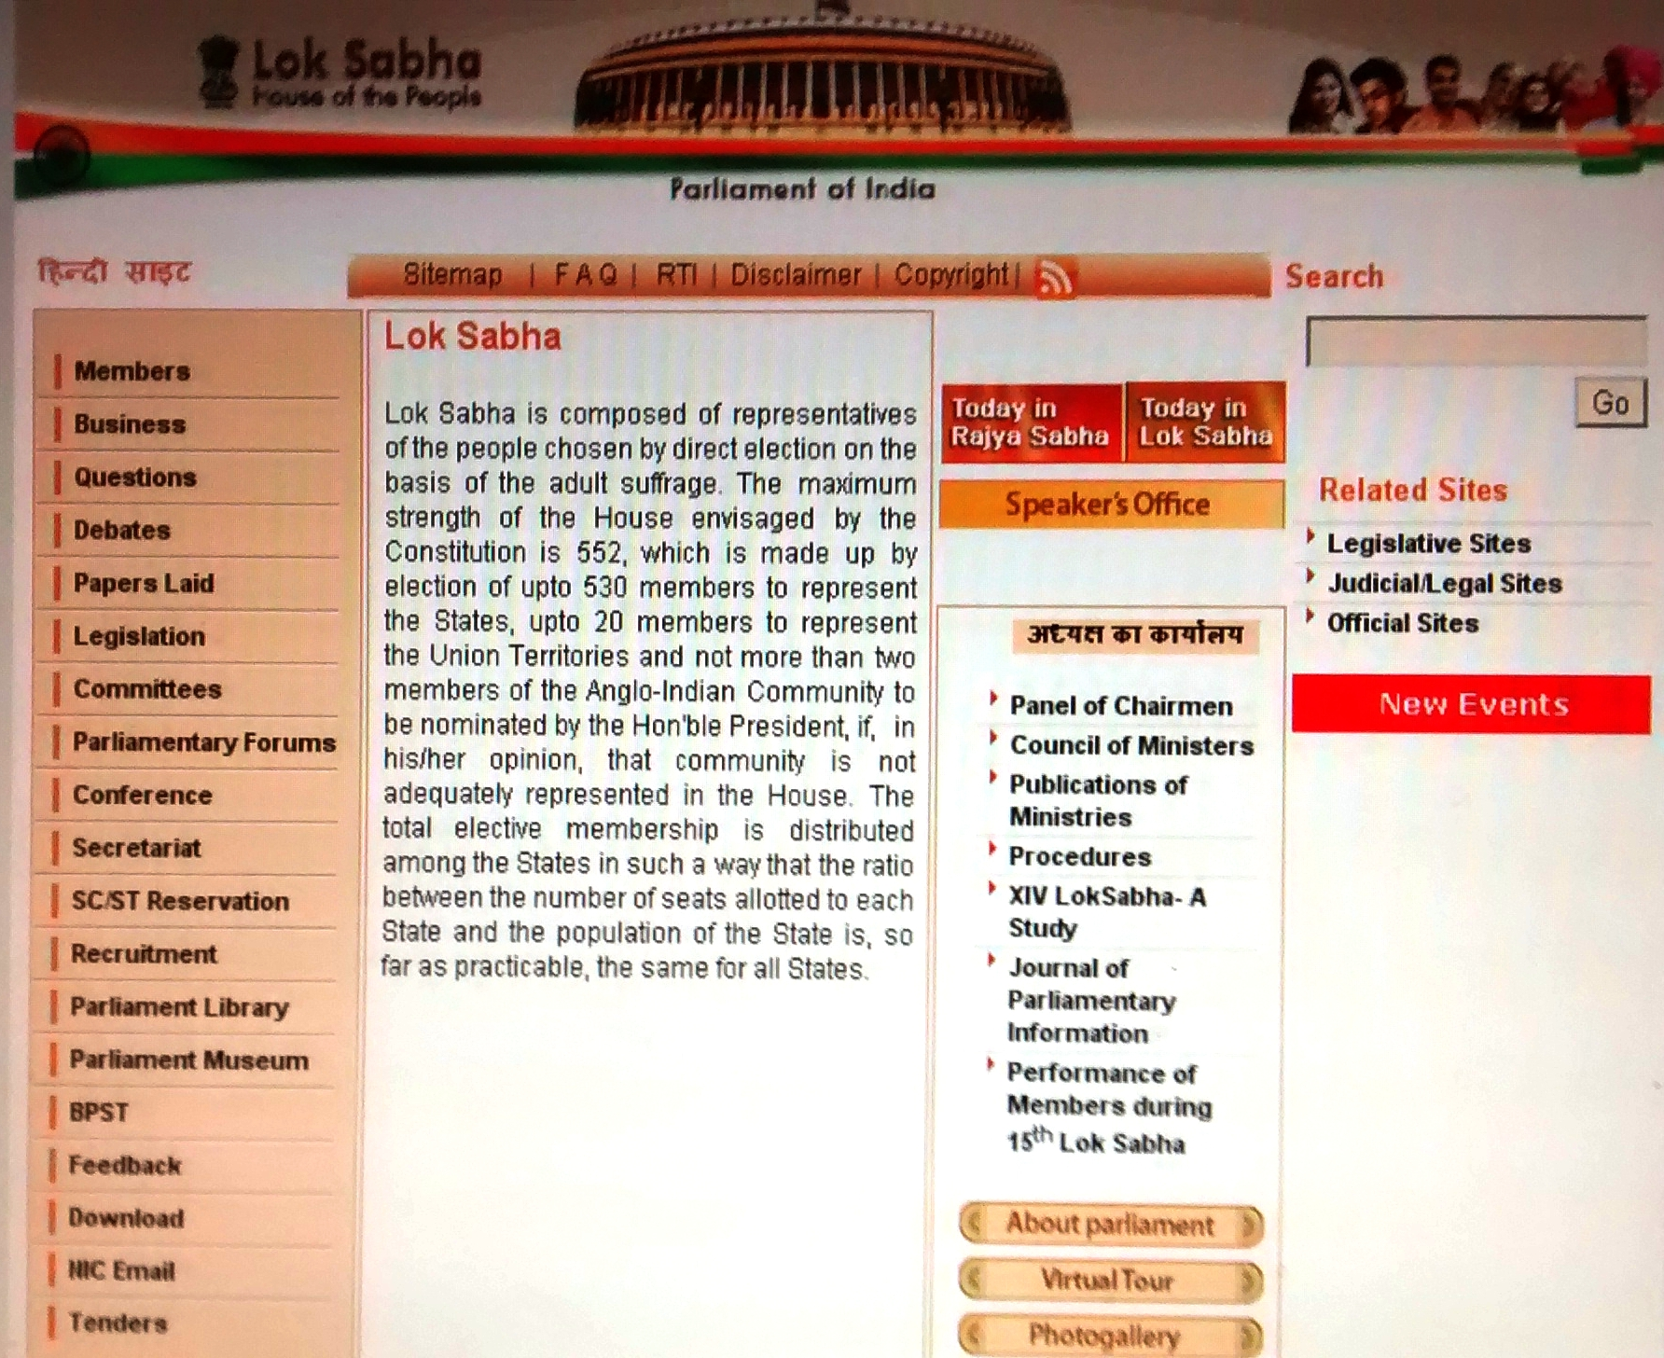
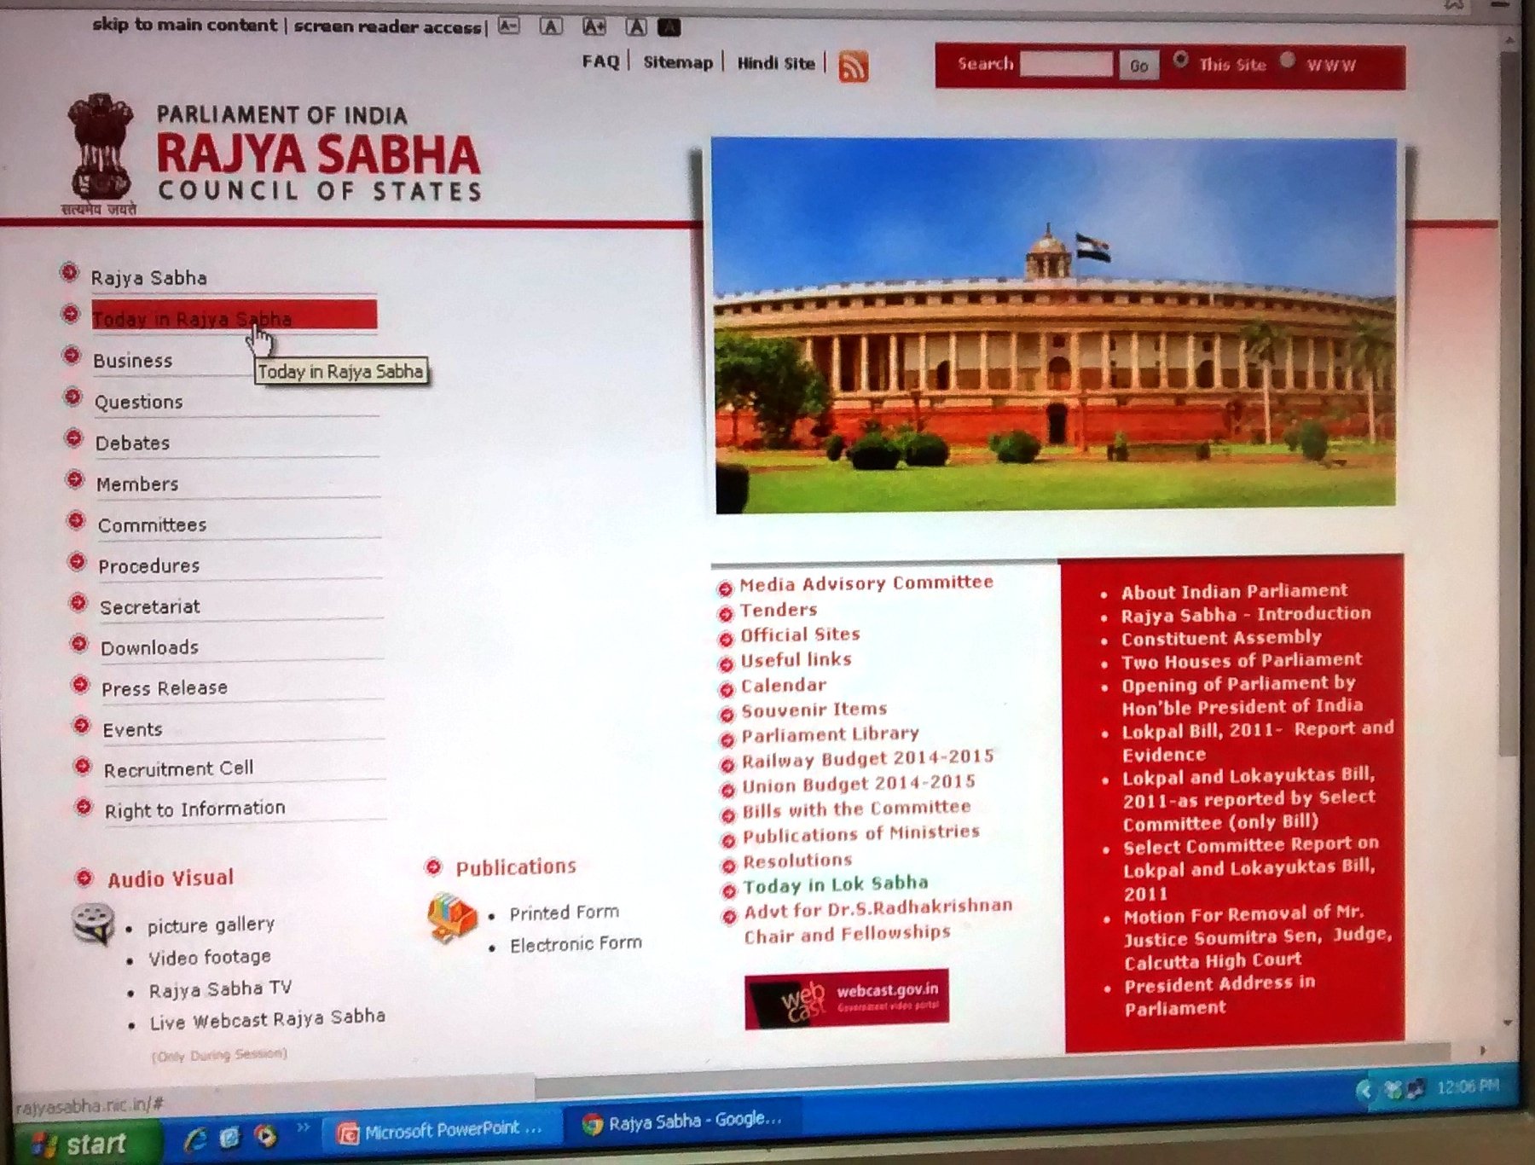
Digitization
Source: www.parliament of India.nic.in

Slide 21
Right to Information Act
The Right to Information Act, came into force on 12 October 2005.
The Act empowers Indian citizens to seek information from a Public Authority, thus making the Government and its functionaries more accountable and responsible.
The Act has now been in operation for over three years and has benefited many
  Only 26% Men and 12 % women, 13 % Rural and 33% Urban population Know about RTI,
  over 26% of the citizens had to pay more than three visits to submit applications forms for RTI .
  Approximately 89% of the PIOs were not using the provision of inspection of records by citizens
  Over 75% of the information seekers were dissatisfied with the quality of information provided
What deters the unveiling of Legislative Process?

Slide 22
Draft Pre-legislative Process (PLP)
On April 26, the National Advisory Council (NAC) has approved a draft pre-legislative process (PLP) for mandatory consultation with citizens before a law is implemented.
The draft recommendation of the Working Group on Transparency, Accountability and Governance, on the ‘pre-legislative process’ suggests that
  The pre-legislative process should also adhere to the principles such as a) transparency, b) inclusiveness and c) equity.
  An executive order be issued requiring all central ministries to follow the pre-legislative process
  The modes of disclosure and consultations would be a part of the guidelines while details of such processes are likely to be worked out by the concerned central ministry/department
What deters the unveiling of Legislative Process?

Slide 23
The Road Ahead
The Journey for the Bill- Green Paper- White paper-Draft Bill
Adequate time for consideration of Bills
Engaging the law makers
Public Awareness Programmes
Voluntary Disclosure
Digitization
.
Identifying and Consulting Stakeholders & Public Discussion on Draft Legislation

Slide 24


Kerala Police Reforms Act
In 2011, the State government of Kerala went all out to ensure true public participation in drafting its police law. The draft Bill was first placed on the Kerala police’s website with an email address inviting feedback from the public at large. Some of the suggestions that were received were incorporated into the draft.
Different groups began lobbying MLAs on the contents of the Bill and its possible impact on people. When the draft Bill was introduced in the House, many MLAs knew about it and acknowledged that, it needed to be referred to a select committee.
From October to November 2011, the 19-member Select Committee, headed by the then Home Minister and comprising MLAs from almost every party, decided to tour the State and hold district-wide town hall meetings. Notices were placed in leading newspapers publicising the committee, its visit and its mandate. In the end, town hall meetings were held in all 14 districts of the State. At least 400-500 people attended every meeting.
The select committee suggested 790 amendments to the original Bill introduced in the House. The Bill was then debated for almost four hours and 240 amendments —many based on the public’s feedback — were accepted and passed
What deters the unveiling of Legislative Process?
Source: The Hindu, 21st February, 2014

Slide 25
CLOSING
Questions
www..jainuniversity.ac.in
52, Bellary Road, Bangalore
manishamadhava
m.manish@gmail.com
91-9900695354
manishamadhava

