Slide 1
Visualizing legislative documents: Paving the way to a meaningful user experience?
Aspasia Papaloi
Doctoral Researcher, Digital Media for Participation Research Group
Laboratory of New Technologies in Communication,
Education and the Mass Media
University of Athens, Greece
apapaloi@media.uoa.gr
Dimitris Gouscos, Assistant Professor, Digital Media for Participation Research Group
Laboratory of New Technologies in Communication,
Education and the Mass Media
University of Athens, Greece
gouscos@media.uoa.gr

Slide 2
Tracking bills
Bill
BILL HISTORY
BILL TEXT
COMMITTEE AGENDA
COMMITTEE PROCEEDINGS
PUBLIC HEARINGS NOTICES
SCIENTIFIC SERVICE REPORT
PLENARY PROCEEDINGS
AMENDMENTS
VOTES

Slide 3
Classification of legislative documents
Historical information
Bill history
Amendments
Encoded information
Votes
Explanatory information
Bill text
Scientific Service report
Public hearing notices
Committee proceedings
Plenary proceedings

Slide 4
Visualization methods based on recent research of 19 Parliamentary Information Visualization (PIV) initiatives
Historical information | Encoded information | Explanatory information
Timeline | Bar chart | Word clouds-Tag clouds
Timeline & parallel coordinates | Area chart | Timeline & bar chart
 | Pie chart | Pie chart
 | Line chart
 | Table
 | Histogram

Slide 5
Historical information: The Making of a Law (Source:http://visualisiert.net/parteiengesetz/index.en.html)

Slide 6
Historical information: Capitolwords (Source: http://capitolwords.org/?terma=iraq&termb=afghanistan)

Slide 7
Explanatory information: Nos Députés (Source: http://www.nosdeputes.fr/philippe-baumel/tags)

Slide 8
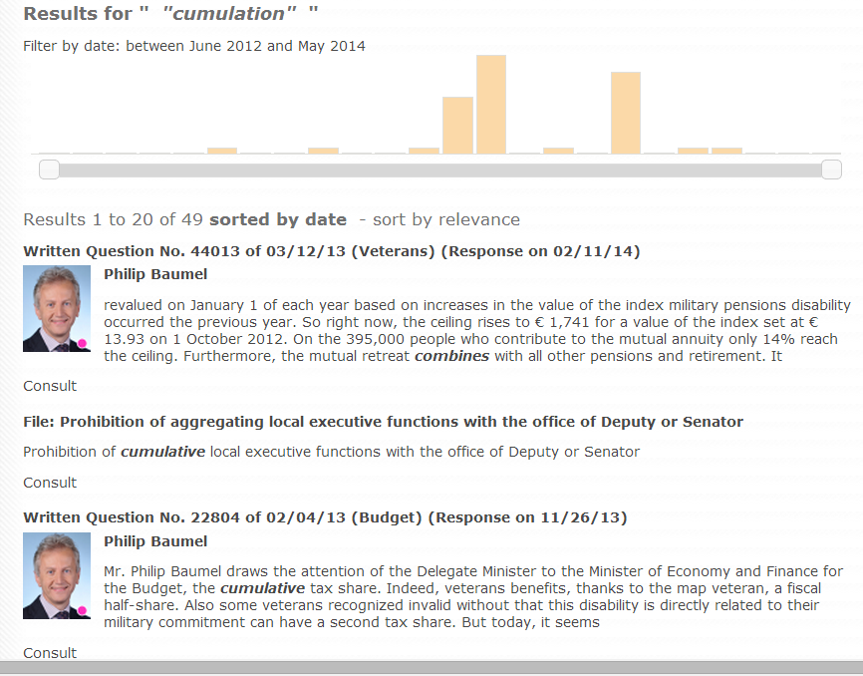

Slide 9
End results…
Wide range of combination possibilities between
legislative documents and visualization methods
One visualization method does not fit all parliamentary information
Each method provides different results based on user perception, needs, interests and on enabler aspirations

Slide 11
Use-centric design…yes, but how?
Users not interested in details
Users interested in details & having knowledge though lack of appropriate tools
Users interested in details
though lack of knowledge

Slide 12
Endless PIV possibilities…Amendments (Source: http://parltrack.euwiki.org/mep/Spyros%20DANELLIS)

Slide 13
Thank you!
Questions and Comments?

