Slide 1
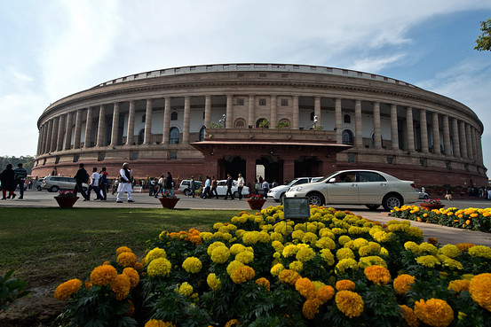
Draft to Enactment – Learnings from Legislative Tracking
Dr. Mandira Kala|May 28, 2014 |Paris

Slide 2
Federal Structure – The Indian Context
National Parliament – bicameral legislature
Lok Sabha (House of the People)
Rajya Sabha (Council of the States)
State Legislatures – bicameral and unicameral
Legislative jurisdiction between Parliament and state legislatures
Notes:
2

Slide 3
Legislative Process in the Indian Parliament
Introduced in one House of Parliament
Presidential Assent
Draft Bill
Referred to Standing Committee
Public feedback invited
Consideration of the Bill
Repeated in other House
Clause-by-clause discussion and voting
Rules and regulations framed
Cabinet Approval
Vote on the Bill

Slide 4
Stage 1: Enablers for Legislative Tracking
Draft Bill
“Black Box’ of Legislative Drafting and Agenda
Absence of a standardised Pre-legislative Process and Consultation
Lack of reasoned feedback from Ministry on comments received
Leverage:
Engaging with Government to create a pre-legislative process
Website/Twitter dissemination on opportunities to give feedback on legislation e.g. Food Security, Land Acquisition
Public feedback invited
Cabinet Approval

Slide 5
Stage 2: Enablers for Legislative Tracking
Scrutiny by Committees e.g. Lokpal (Corruption Ombudsman for public officials)
Circulation of Amendments and Legislative Debate in Parliament
Voice vs. Recorded Vote of MPs
Leverage:
Engaging with Committees inviting comments e.g. Criminal Laws Bill
Tracking Proceedings Data e.g. 116 Bills, 36% passed in Lok Sabha were debated for less than 30 minutes. 20 Bills were passed in less than 5 minutes
Introduced in one House of Parliament
Referred to Standing Committee
Consideration of the Bill
Clause-by-clause discussion and voting
Vote on the Bill

Slide 6
Stage 3: Enablers for Legislative Tracking
No comprehensive public database of the dates of enforcement of various laws – partial notification and no notification
Government rule making process not transparent
Leverage:
Maintain database on laws enacted since 1990
Engaging to citizens/experts e.g. Companies Rules Information Technology Act, Civil Liability for Nuclear Damage Act
Presidential Assent
Rules and regulations framed

Slide 7
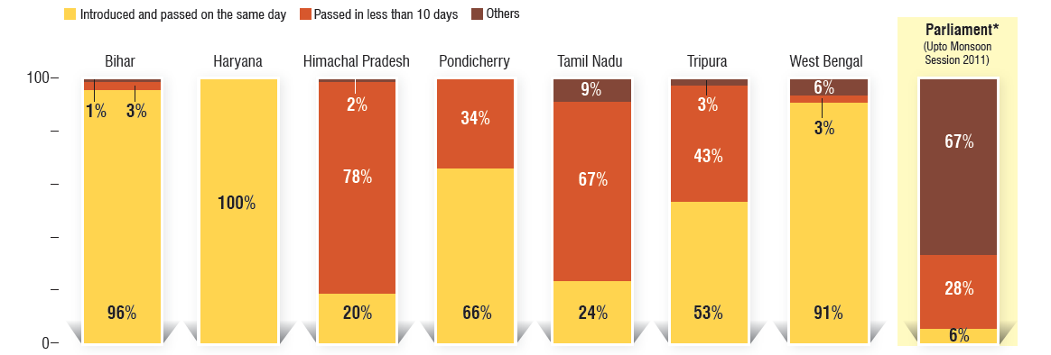
Legislative Process in State Legislatures in India

Slide 8
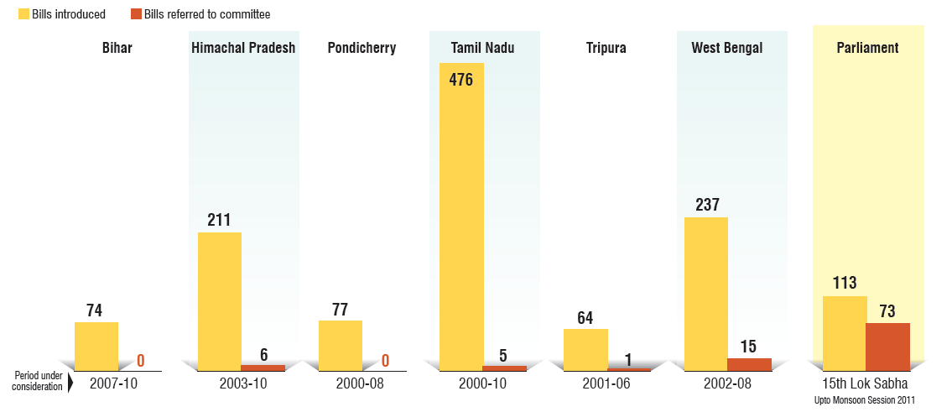
Legislative Process in State Legislatures in India

Slide 9
Summary – Structural Constraints in Tracking Legislation
Dependence on Parliament to place legislative information in public domain
Non-standardised format of data– PDF; non-standardised/ non digital formats – image files!
Unpredictability of legislative process

Slide 10
Using technology to make the legislative process more transparent and participatory
How do you connect citizens to the legislative process and opportunities for engagement?
REAL TIME LEGISLATIVE UPDATES:
Create an Citizen Mobile App - Alert on how a legislative proposal is being discussed and at what stage of the process
TEMPORAL TRACKING OF LEGISLATION:
Draft to Enactment – amendment to Laws and regulations – user friendly, searchable format
Database on how many laws exist - 1500 central laws. How many state laws? www.lawsofindia.org

Slide 11
Thank You mandira@prsindia.org PRS Legislative Research| New Delhi| India www.prsindia.org|@prslegislative

