Slide 1
A COMMITMENT TO SOCIABILITY IN parliament
Romain Lecler

Slide 2
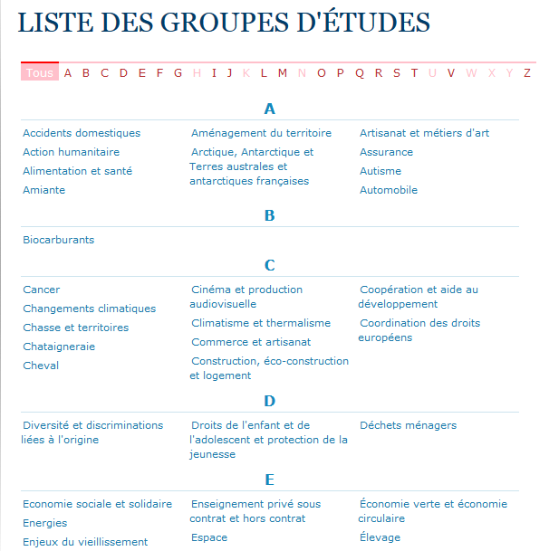
The LIST OF STUDY GROUPS withIN THE NATIONAL ASSEMBLY
Accueil > Les députés > Liste des groupes d'études

Slide 3
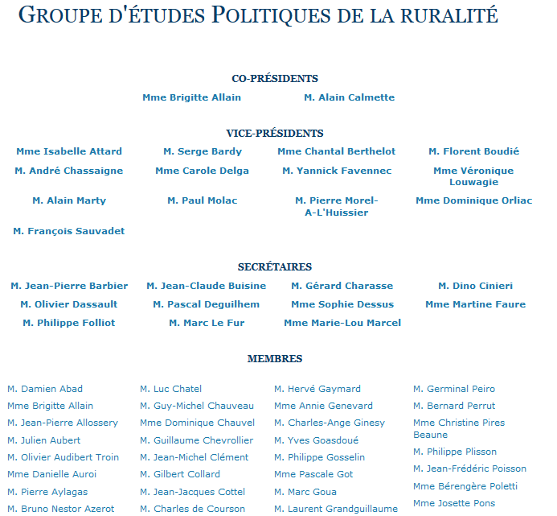
MEMBERS OF THE STUDY GROUP ON RURAL POLICIES
(…)

Slide 4
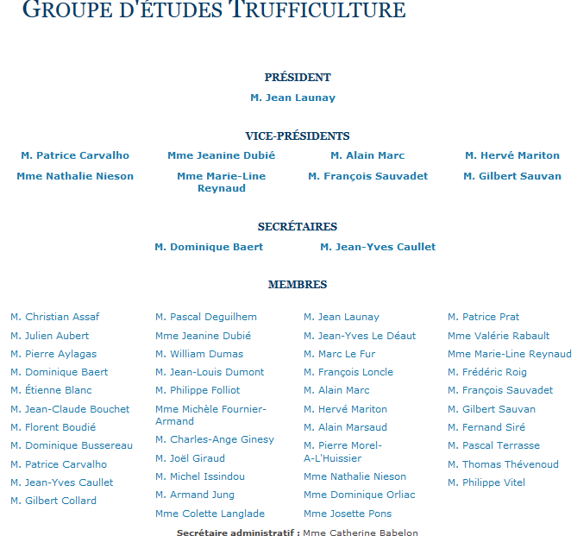
MEMBERS OF THE STUDY GROUP ON TRUFFLES

Slide 5
MOST POPULATED STUDY GROUPS
“Rural Policies” | 139
“Commerce and Crafts” | 123
“Hunting and Territories” | 119
“Tourism” | 119
“Small Business” | 114
« Food Industry » | 110
“Regional Languages” | 109
“Wine Production” | 96
“Equitable Economy” | 93
“Car” | 91
“Country Planning” | 89
“Oil Shale Extraction” | 85
“Animal Breeding” | 81
“Ageing Population” | 81
“The Internet and the Digital Society” | 80
…and "Truffle" (43), “Balneology” (42), “Granite and Quarries” (42), “Tibet” (41), “Corrida” (35), “Cancer” (32), « "Chestnut Groves" (25), "Sign Language" (25).

Slide 6
LEFT/WING UNBALANCED STUDY GROUPS
Study Group | % PS | % UMP
Asbestos (Amiante) (n=36) | 68 | 32
Sustainable Economy (n=46) | 61 (18% Green Party) | 26
Equitable Economy (n=93) | 72 | 20
Gender and Women Rights (n=28) | 69 | 23
Poverty, Job Insecurity and Homeless Population (n=58) | 64 | 26
Debt Burden (n=54) | 63 | 29
Langues regionales (n=109) | 59 | 36
Private Education (n=52) | 10 | 88
Family and Fostering (n=60) | 22 | 73
Space (n=47) | 17 | 76
Sects (n=42) | 29 | 61
Health Professions and Coordination (n=40) | 31 | 67
Cross-Border Workers (n=56) | 31 | 59
Small Business (n=114) | 30 | 58
Beer Industry (n=43) | 29 | 66

Slide 7
COUNTRIES WHERE LEFT/RIGHT MPs are overrepresented within “Friendship Groups”

Slide 8
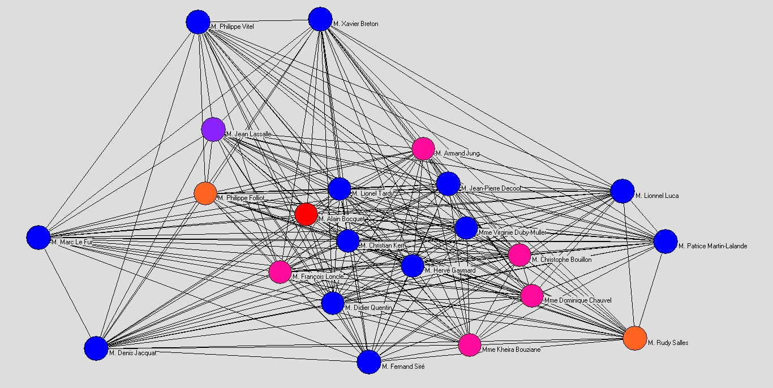
MOST CENTRAL MPS ACCORDING TO THEIR PARTICIPATION IN STUDY GROUPS

Slide 9
22 CENTRAL MPS in STUDY GROUPS
UMP | Rank in Activity | Number of Reelections
Philippe Vitel | 115 | 2
Xavier Breton | 43 | 1
Marc Le Fur | 1 | 2
Denis Jacquat | 26 | 3
Fernand Siré | 70 | 1
Didier Quentin | 97 | 3
Lionnel Luca | 64 | 3
Patrice Martin-Lalande | 195 | 3
Lionel Tardy | 32 | 1
Virginie Duby-Muller | 108 | 0
Christian Kert | 324 | 3
Jean-Pierre Decool | 39 | 2
Hervé Gaymard | 165 | 1
PS
Armand Jung | 497 | 3
Kheira Bouziane | 251 | 0
François Loncle | 403 | 3
Dominique Chauvel | 492 | 0
Christophe Bouillon | 275 | 1
UDI
Rudy Salles | 100 | 3
Alain Bocquet | 90 | 3
Philippe Folliot | 135 | 2
Non Registered
Jean Lassalle | 436 | 2
REELECTIONS
Average MP reelections = 1.1
Average central MPs reelections = 1.9
ACTIVITY
Average activity share of 1 MP = 0.18%
Average activity share of central MPs = 0.31%

Slide 10
INDEX OF ACTIVITY SHARE in NATIONAL ASSEMBLY
Index of Activity = (38/17535+66/31795…) /12
http://www.nosdeputes.fr/synthesetri/4
Name | Semaines d'activité | Commission |  | Hémicycle |  | Amendements |  | Rapports | Propositions |  | Questions
 |  | réunion | interv. | Interv. | interv. | signés | adoptés | écrits | écrites | signées | écrites | orales
 |  |  |  | longues | courtes
Damien Abad | 38 | 66 | 82 | 291 | 295 | 1143 | 38 | 2 | 2 | 114 | 68 | 5

Slide 11
conclusion
The characteristics that such “central” MPs have:
- Most of them are right-wing, in an Assembly that has a clear left-wing majority.
- They have been reelected many times, much more than the average.
- They are much more "active" MPs than the average.
- A very few of them seem to have any chance to access a government position.
This may help to see an opposition between MPs investing on positions outside of the Parliament (e.g. in a government, especially if they belong to the majority) and MPs investing on the sociability within the French National Assembly, as measured by their commitment to study groups.

