Slide 1
Challenges of the Digital Democracy Commission
Cristina Leston-Bandeira, University of Hull
May 2014

Slide 2
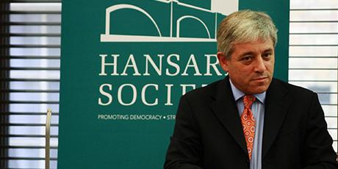
Why has this Commission been set up?
Growing demand and opportunity for a Digital Democracy
Technological revolution of past 25 years
The Speaker of the House of Commons announced his Digital Democracy Commission (DDC) in a speech to the Hansard Society on 27 November 2013
How can we reconcile institutions and traditional concepts of representative democracy with this technological revolution?
Notes:
Image: UK Parliament

Slide 3
Why a Commission?
New, unique and because it is outside Government, is non-party political
Maximum involvement of people / organisations
Open to anyone who wants to participate
Evidence, views and information from people of all walks of life and across Britain, and from wide range of organisations
Look at the issues from a ‘helicopter’ view
Notes:
Image: iStockPhoto
Wide range of organisations: from Universities to community groups, from Think Tanks to companies
Explain methodology in more detail: calls for evidence linked to themes; open evidence on other.
Organisation of events. Facebook roundtable. Student forum online
Promotion of discussion, development of ideas

Slide 4
Who is on the Commission?
Members of the core group are:
Rt. Hon John Bercow MP (the Speaker of the House of Commons)
Robert Halfon MP (Member of Parliament of Harlow)
Meg Hillier MP (Member for Hackney South and Shoreditch)
Paul Kane (President of CDNS.network)
Helen Milner (Chief Executive of the Tinder Foundation)
Dr Cristina Leston-Bandeira (Senior Lecturer at the University of Hull)
Emma Mulqueeny (founder of Rewired State and Young Rewired State)
Femi Oyeniran (actor/filmmaker) and Toni Pearce (President of the NUS) - as a job-share
There is also a wider group of ‘Champions’ who support our work
Notes:
Image: UK Parliament
Variety and wide range of organisations reflect wish to consult beyond usual suspects
To note only three politicians; and other members v diverse. Only one academic. A filmmaker; experts on digital; experts on digital inclusion (i.e., the non digital); youth voice

Slide 5
What are the aims of the Commission?
The Commission will consult, consider, report and make recommendations on how UK Parliamentary democracy can embrace technology to become more effective in:
Representing the people
Making laws
Scrutiny
Encouraging citizens to engage with democracy
Facilitating dialogue amongst citizens
Notes:
Image: iStockPhoto

Slide 6
What are the timeframes for the DDC?
Work began in January 2014
Over the next months: gathering of information and evidence from a variety of sources before
Recommendations drawn up in the Autumn of 2014
Final report: early 2015
Notes:
Image: UK Parliament
Final report to coincide with Parliament’s 750 birthday and the 800 anniversary of the sealing of the Magna Carta

Slide 7
Key challenges – the paradoxes
Low turnout
Low trust
Increase skepticism
Increase direct action
Increased transparency
Increased accessibility
Increased participation
Many more elections
Notes:
Although representing DDC, also bringing my own academic perspective and input

Slide 8
Addressing the Puzzle
Very wide ranging audiences
Law: realm of the expert?
Language barriers
Education role?
Sheer volume & complexity
link, integrate, explain
Institutional processes and powers
Citizen input?
Resources - Capability
Notes:
Complexity: digital should provide tools to address it>> link, integrate, explain
But raises new questions about institutional processes – within parliament, and cross-institutional (Gov/Pa/Judiciary) - and political powers (Gov vs Pa; Parties)
And where does citizen input come into? Should it a stop at the level of access and understanding, or should it go further?
>> Public reading, adding comments to legislation under discussion; initiating legislation (citizen legislative initiative, EU and other); Petitions?

Slide 9
Initiatives – tying the knots together
GoodLaw - www.gov.uk/good-law
Legislative Drafting, Amending and Publication Programme (LDAPP)
Online video service
Public reading
ePetitions
Digital engagement
Notes:
GoodLaw - www.gov.uk/good-law - government led (Cabinet Office) towards “making legislation work well for the users of today and tomorrow”
The Legislative Drafting, Amending and Publication Programme (LDAPP) involving:
National Archives and the Queen’s Printer for Scotland (which publish legislation and keep it up to date),
the two Houses of the UK Parliament, the Scottish Parliament,
the Office of the Parliamentary Counsel and the Office of the Scottish Parliamentary Counsel (who draft Government Bills).
Online video service:
mobility, search-ability, navigation, integration with open data;
target: end of 2014
Key as a user enabling tool
Public Reading
Piloted on three occasions (by both government and parliament)
Parliament’s pilot: Children and Families bill, early 2013
Public Reading open in February 2013, for 14 days
1402 comments, 1099 published
Forum comments submitted as written evidence to Public Bill committee
E-Petitions
Government led
High usage; unclear as to consequences and process
Moving towards new model, to be considered, parliament led
Digital engagement: We Nurses
Mainly at the scrutiny level>> going outside the institution to engage within the space of dynamic online communities
But could it spread to legislation also?

Slide 10
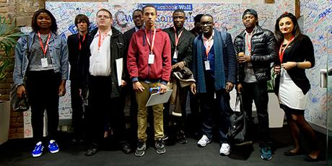
Summing up
Digital Democracy Commission: unique
Methodology: to listen from as wide range sources as possible
Making the most of opportunities and meeting demands of digital transformation
Legislation: about complexity and volume, but also more fundamental institutional questions
Plenty going on already
Notes:
Image: Uk parliament

Slide 11
How can I get involved?
The Speaker and members of the Commission are keen to hear your views. There are various ways of contacting us:
Tweet: @digidemocracyuk
Email: digitaldemocracy@parliament.uk
Or use our web forum:
http://www.parliament.uk/business/commons/the-speaker/speakers-commission-on-digital-democracy/web-forum/
Notes:
I would encourage you all to submit evidence. Lessons and experiences from abroad are very useful for our purposes.

Slide 12
Thank you.
Photos from www.parliament.uk and iStockPhoto
c.c.leston-bandeira@hull.ac.uk

Slide 13
This is what the statute book looks like
"Diagram from legislation.gov.uk licensed under the Open Government Licence V2.0"
Notes:
© John Sheridan - Diagram from legislation.gov.uk licensed under the Open Government Licence V2.0
HR
This slide is an illustration mapping the effect of one piece of new legislation across the existing statute book. Think of this multiplied by the number of new Acts and SIs each year and you start to form a picture of the magnitude of the problem facing people trying to access legislation.
The problem:
The sheer volume of legislation
Its piecemeal structure – freestanding Acts, Acts which amend other Acts, several Acts all operating in the same area, different pieces of legislation for different jurisdictions, different pieces of legislation applying to different periods of time (some perhaps not in force for long periods), division of law between Acts and SIs (full picture may only emerge by fitting them together).
The level of detail that is included in legislation
Frequent amendments
The interaction with common law
The interaction with European law
Even professional users can find law complex, hard to understand and difficult to comply with. The digital age has made it easier for people to find the law of the land; but once they have found it, they may be baffled. The law is regarded by its users as intricate and intimidating.

